Slide 1
Multi-threading
COEN 346 – Winter 2025

Slide 2
Outline
Threads
Things to keep in mind
Create a simple thread
Passing input to a thread
Fetching output from a thread
Common threads control utilities
Conclusion
Lab activity (Programming Assignment #1)

Slide 3
Threads
You will see the theory during the lectures very soon.

Slide 4
Threads
The smallest execution unit
Shared Memory
They can
Execute a routine (sometimes even periodically)
Return values
Challenges
Communication (synchronous Vs asynchronous)
Scheduling
Control access to shared data

Slide 5
Things to Keep in Mind
What is the thread supposed to do?
The logic or the routine executed by the thread
To what it is doing it?
Input values
What should happen after the execution of the invocation
Output
When should the execution happen?
Scheduling, synchronization, etc.

Slide 6
Create a Simple Thread

Slide 7
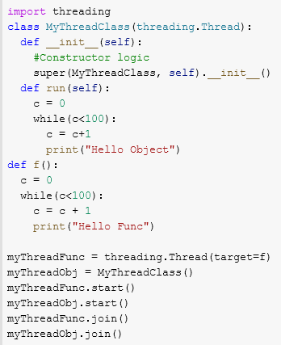
Python
Module to import
A subclass of threading.Thread that redefines the method (run) that encapsulates the logic to be executed by the thread
A function that encapsulates the logic to be executed by the thread

Slide 8
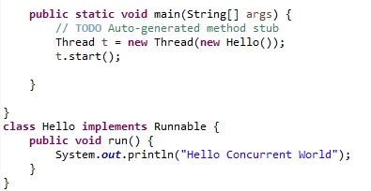
JAVA
Import
Java.lang.Runnable
Java.lang.Thread
Encapsulate the behavior of the thread in a method of a class as seen with python

Slide 9
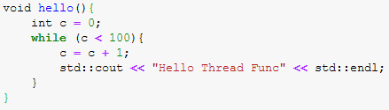

C++
Include
<thread>
Encapsulate the behavior of the thread in a function as seen with python
Note how in C++ we do not need to call start

Slide 10
Passing Parameters to a Thread

Slide 11
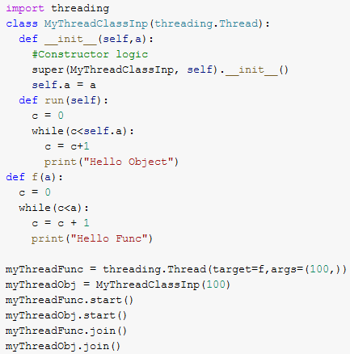
Python
Input added as an attribute of the class
Input added as parameter in the function definition
Parameter values are passed in a tuple in the same order in which they appear in the definition

Slide 12
JAVA
One can use the same technique as it was seen in python when the behavior is encapsulated in a method of a class

Slide 13
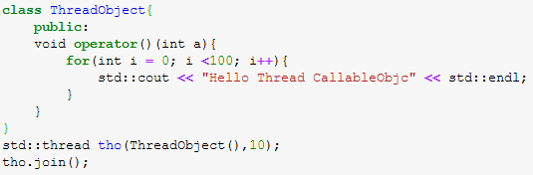
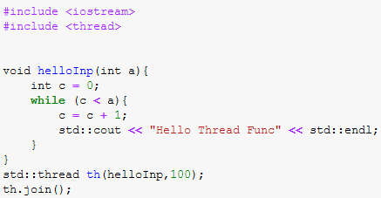
C++
One can use the same technique as it was seen in python when the behavior is encapsulated in a function
Function objects can also be used
When the class overloads the function call operator

Slide 14
Fetching Output from a Thread

Slide 15
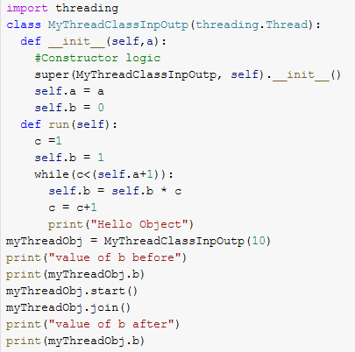
Behavior of the Thread in a Method
Output can be treated the same way as input
Add an attribute of the class that will hold the output
The value of this attribute may change as a result of the thread execution
This works when the behavior of the thread is encapsulated in a method
python
JAVA

Slide 16
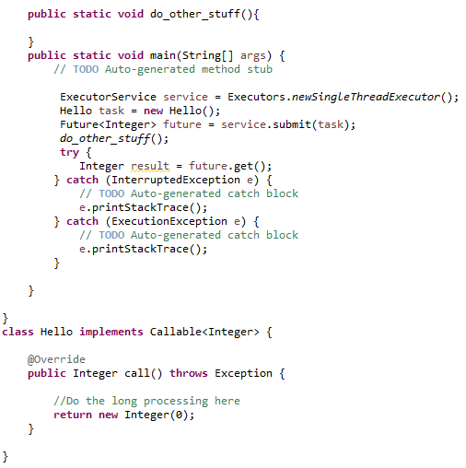
Behavior of the Thread in a Method(Cont’d)
JAVA
On the call of future.get(), the execution will block until the method call is executed completely
Define a class for the callable which will redefine a method (call) to encapsulate the routine of the thread
Note how the class (Integer) used to parameterize the generic interface Callable matches the return type of the method call

Slide 17
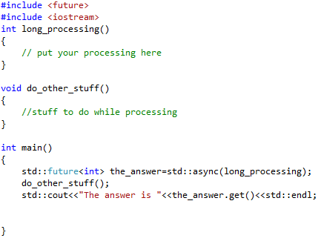
Behavior of the Thread in a Function
Define a function that encapsulates the routine to be executed by the thread. In this case this routine returns an int
Std::async function can be used to invoke the function, it returns a future (template object) that can hold a content of the same return type as the invoked function (int in this case)
wait() method is a blocking call that waits for the execution to finish and returns the returned value ➔ it should be called before the method get()

Slide 18

Behavior of the Thread in a Function(Cont’d)
Python in its module concurrent.futures, mixes between C++ style and JAVA callables
It supports certain types of Executors such as ThreadPoolExecutor
Tasks can be passed to the Executor using submit method which returns a future object
Unlike JAVA the tasks are defined as functions and not classes
To wait for the execution to finish and fetch the result one can invoke on the future object the method result()

Slide 19
Common Threads Control Utilities
join(): a method used to make a thread wait for another one to finish (Rendez-vous)
detach(): used in C++ to tell a thread that it does not have to wait for another one

Slide 20
Conclusion
The behavior that needs to be invoked in a thread should always be encapsulated somewhere
A function
A redefinition of a method of a superclass (run, Runnalble.run(), Callable<?>.call())
A redefinition of an operator (function objects in C++)
Lambda expressions
Adding parameters and passing their values during an invocation can be done in different ways
Directly if using functions
As attribute of the defined classes if the behavior is encapsulated in a redefined method
Output (when available) can be fetched in different ways
Through attributes of the defined class that has the behavior executed by the thread
Using future objects

Slide 21
Lab Activity
Discuss Programming Assignment #1

